Slide 1
<Data visionaries>
Pujun Xie
Terlo Adam
Syed Ali

Slide 2
Project statement
To enhance the security of DevOps and MLOps, we are going to develop a container scanning service which can integrate into the CI/CD pipeline of DevOps and MLOps. Container scanning refers to analyzing the contents and build process of container images to detect security issues such as vulnerabilities and faulty practices. It can be as a first line of defense which helps us detect security issues and stop them before they are exploited. In addition, it is easy to implement and can be CI/CD automated. So, it is one of the most essential workflows for secure DevOps and MLOps.
Project repo: <https://github.com/xpjllk38324/Container-Security-Scanning-Service>
This report: <https://github.com/xpjllk38324/Container-Security-Scanning-Service/blob/main/Product%20Definition/Product%20Definition.pptx>

Slide 3


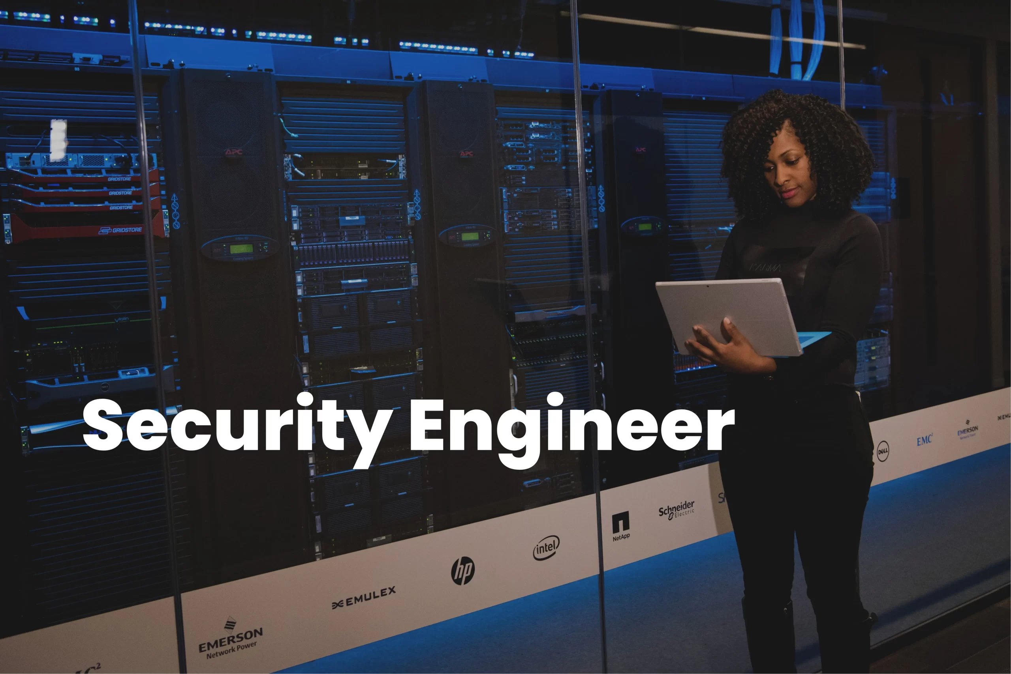
Roles
DevOps Engineer
DevOps engineers can integrate our service into the products for improving safety.
Developer
Developers can use our service to improve the safety of application.
Information Security Engineer
Information security engineers can use our service to conduct
container security test.

Slide 4
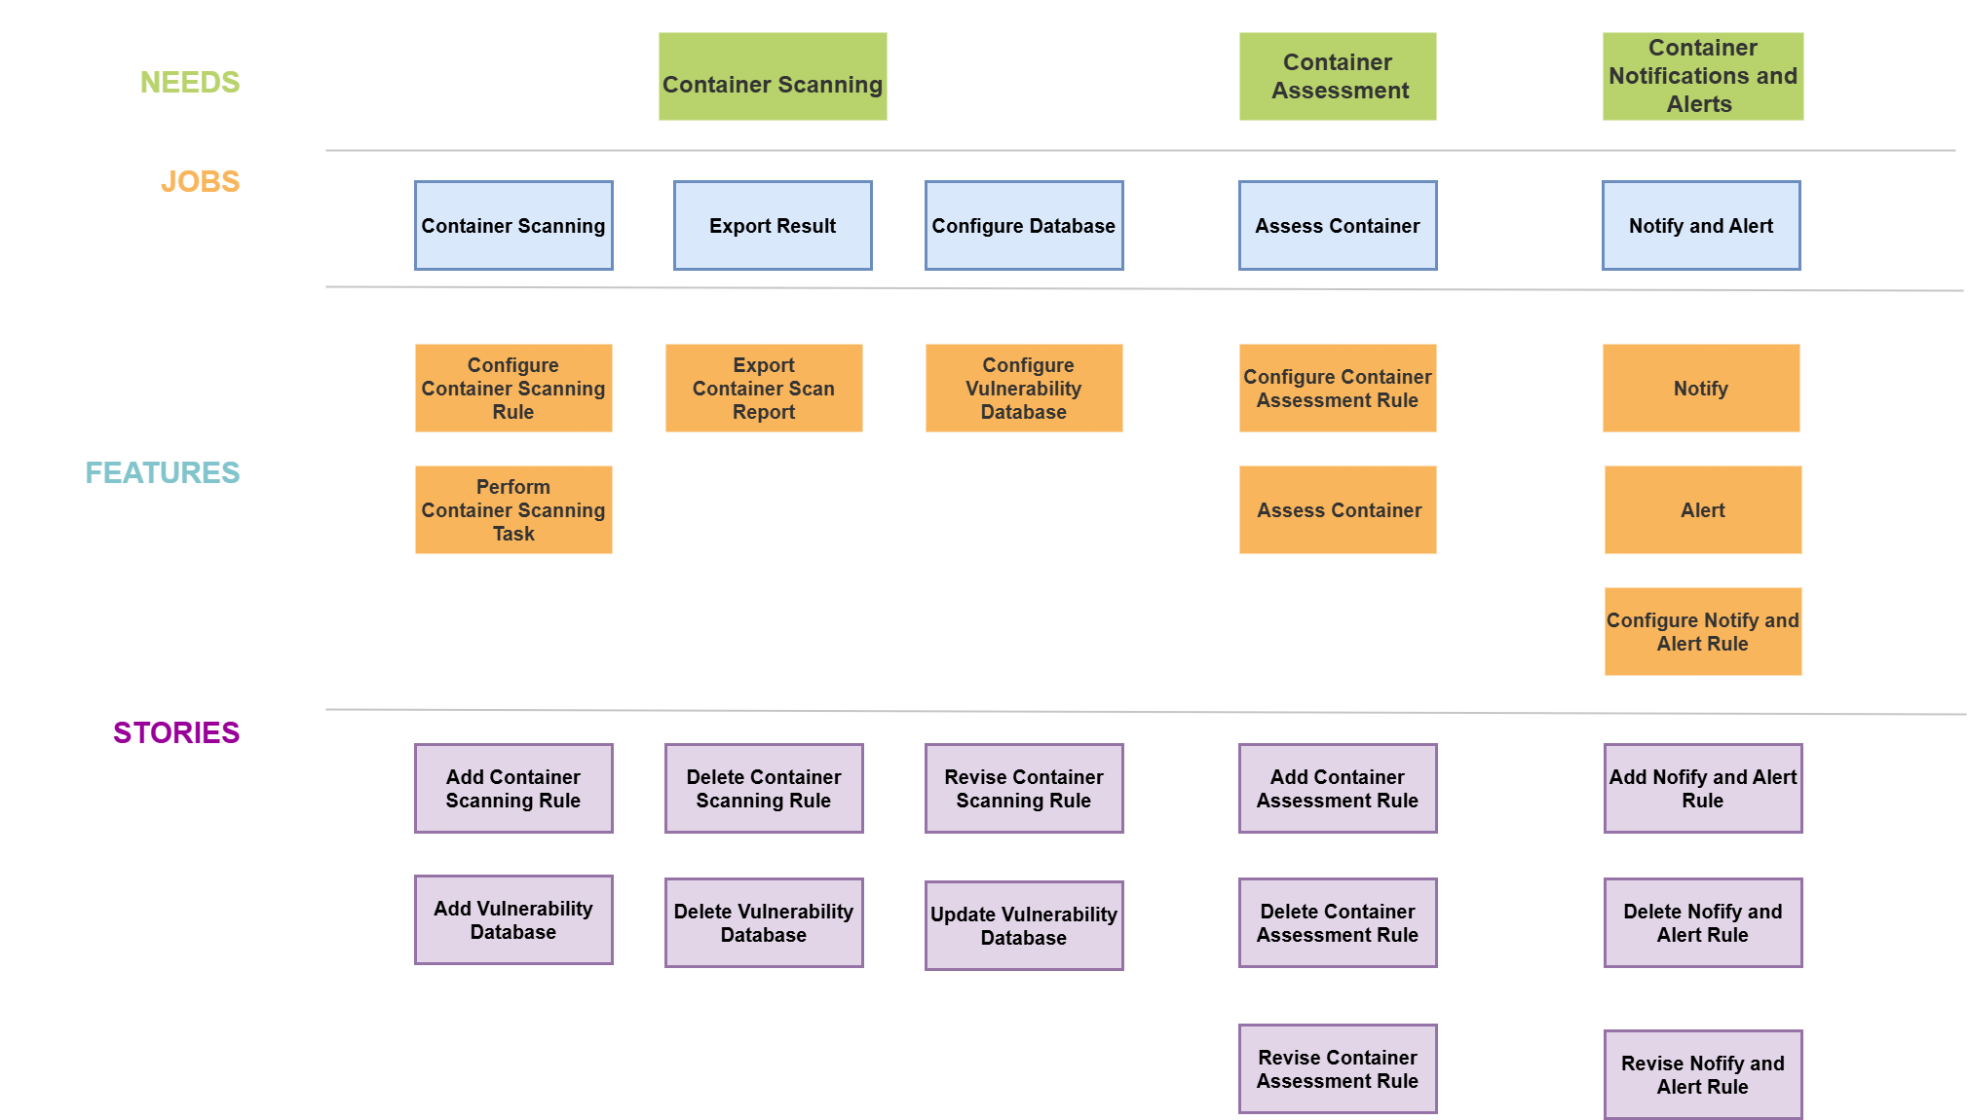
Storymap

